Slide 1
EDA Lab 13
File created on: 14-10-2024 10:43:12

Slide 2
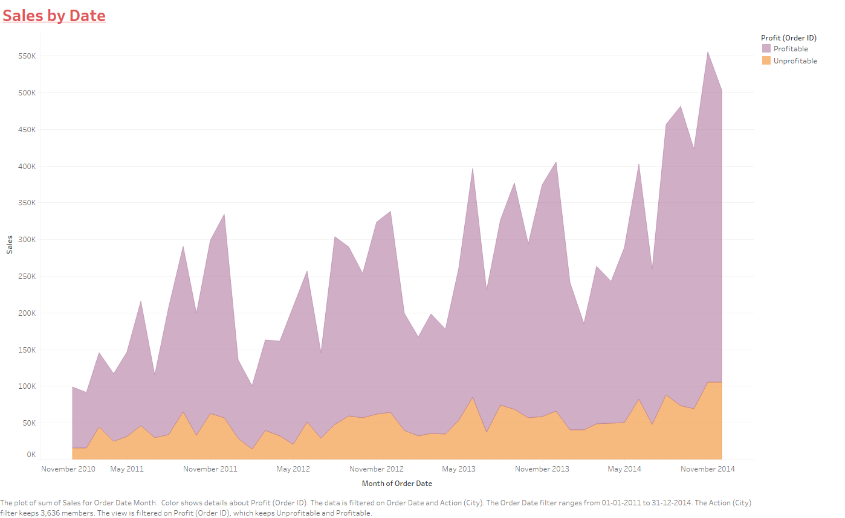

Slide 5
